Slide 1
Writing User Stories Made Real

Slide 2
Contents
Problem Statement 3
User Story Writing Basics 4
User Story Writing Case Study 9
Hands-on Exercise 21
Key Takeaways 22
What’s Next 23
Our Ask 24
Team 26

Slide 3
Problem Statement
Writing good user stories is essential to the success of an Agile project and has become the top issue on many projects
It is a change in scope
You didn’t tell
There is too much back and forth
Nah, just an additional level of detail !
But, user story is not well documented
Well, you didn’t ask !
SOUND FAMILIAR ?
Symptoms of Bad User Story Writing
User Stories were not completed in the Sprint
User Stories changed during the Sprint (or new ones had to be created)
Sprint Testing happened the last day or two of the Sprint
Development didn’t start the first day of the Sprint
Burndown looked like a hockey stick
Too much “chatter” between developers and functional team
Sprint Planning required more than 3 – 5 minutes per User Story
Time to complete “simple” User Stories was twice as high and time to complete “hard” User Stories was less than expected
Impact on Project Delivery
Acquired functional/technical debt for future Sprints
Scope evolved as additional details were uncovered
Testing team was under-utilized the first half of the Sprint and over-committed at the end of the Sprint (potential quality issue).
Inability to monitor progress during the Sprint
Lower velocity due to lost developer productivity
Backlog grooming for future Sprints suffered
User Stories lacked required design details and complete acceptance criteria
Estimates were inaccurate making it difficult to commit to Sprint outcomes

Slide 4
Decomposing business requirements
A Theme is a top-level objective that may span projects and products
Visualization: Journey Map
Example: Personalize user experience
Requirements
Imagine. Refine. Design.
Defining requirements at various levels of increasing granularity provides structure for the product backlog. As requirements mature through the refinement process, high-level themes outlined in the roadmap break down into lower-level requirements.
Themes
An Epic and feature is a collection of related capabilities that support a business process. Epics are too large to be completed in a single sprint, but achieve a common goal. Features are a breakdown of epics into smaller pieces.
Visualization: Roadmap
Example: Allow users to create user profiles
Epics and Features
A User Story is a description of desired functionality told from the perspective of a user
Visualization: Process Flow
Example: As a registered user, I want to reset my password so that I can login into the site if I forget my password
User Story
Task
Tasks are individual activities that are required for a User Story to be “done”
Example: Author acceptance test for User

Slide 5
Types of work in the backlog
All business requirements are defined in the product backlog through user stories. However, additional work is captured in the backlog to support the non-functional needs of the project.
Issues
Functional User Stories
Technical User Stories
Requirements that describe system behaviors which are most often driven by the user leveraging the application.
Requirements that are not about specific functionality, but rather an attribute or characteristic of the system. Examples include reliability, availability, security, scalability, usability, maintainability, and performance.
Product
Backlog
Spikes
Maintenance
Requirements that are not fully known but result in learning, architecture design, or prototypes. They are ultimately feed a new set of stories and identify an execution strategy that will meet the functional goal of the spike.
Requirements that analyze the potential impact of new releases and system updates. They modify or enhance existing functionality to account for the software and/or infrastructure changes.
Risks

Slide 6
Consider a backlog board for visibility
Refinement is foundational and ongoing
 | Draft | Being Refined | Arch \ Dev Review | QA Review | Ready to be Estimated | Estimated
Epic
By the end of the Discovery phase, a product backlog must contain at least three sprints worth of estimable user stories. Once a scrum team begins sprinting, output will suffer if sufficient time is not consistently allocated to continue growing the backlog in parallel with current development.
A Backlog Board provides functional insight into the status of your backlog because it categorizes user stories by refinement progress. This holds the entire scrum team accountable for user story definition thereby minimizing the risk of delays and issues once the story is pulled into sprint.
Using a Kanban style board to organize the product backlog provides an added layer of visibility into user story maturity and structures backlog refinement sessions.
Refinement Status Definitions
Draft: Requirement is identified but story has yet to be refined
Being Refined: Functional Team updates acceptance criteria and creates supporting process documents
Arch / Dev Review: Developers review acceptance criteria and provide high-level design which is consistent with architecture design
QA Review: Testers review acceptance criteria and create test data
Ready to be Estimated: Product Owner confirms priority
Estimated: User story is assigned story points and is ready for sprint

Slide 7
Techniques for splitting stories
Most user stories require decomposition as business processes are explored and new scenarios arise. Use these techniques to keep user stories estimable while maintaining functional integrity and aligning with the INVEST principle for writing high-quality user stories.
Workflow Steps
System Qualities
Business Rule Variations
Operations
Variations in Data
Use Case

Slide 8
Definition of Ready (DoR)
The DoR is defined by the scrum team during the Discovery phase and is reviewed at the start of every sprint during sprint planning to ensure stories are fully refined and ready for development.
User Story
is ready
to be pulled into a Sprint.
User story defined
As a <<some class of user>> I want <<some enhancement or feature>> so that I derive <<some form of value>>
Acceptance criteria defined
Given <<scenario>>, when I <<action>>, the <<result>>
User story has business value and is relevant to the business goal of the sprint
User story sized by the sprint team
Story can be estimated in 15 minutes
No story is larger than ½ sprint capacity
Supplemental documentation prepared
Sample test data
Wireframes
Process flows
User story dependencies identified
No external dependencies exist which block the user story
Stories have been validated and the Sprint is ready.
All user stories meet the DoR
All user stories are estimated
All tasks for user stories cannot be greater than 1 working day
Sprint contains all prioritized defects and user stories
Sprint capacity is confirmed

Slide 9
New York Life User Story Writing Case Study Case in Point Feature: Authentication & Verification

Slide 10
NY Life: Feature Breakdown – Process
Feature
Vision Discussions
Feature
Design Discussions
Feature
User Story Breakdown
User Story Sign off &
Solution Design Sign Off
Owner: Business Analyst
Participants: Product Owner, Business SMEs, Tech Solution Lead, BAs
Expected Outcome:
Define the vision for a Feature
Create detailed process flow
Persona Slide
Meeting Cadence for the Feature (Requirements sessions, User Story Sign-off sessions with PO and Grooming calls)
Owner: Technical Solution Lead
Participants: Tech Solution Lead, BAs
Expected Outcome:
Define the tech design for the feature covering Salesforce, integration, Vlocity (mobile and web) and data aspects
Owner: Business Analyst
Participants: Product Owner and BAs
Expected Outcome:
Create 1st draft of functional, integration and data user stories
Create screen mock-ups
Owner: BA/Tech Solution Lead
Participants: Product Owner, Tech Solution Lead and BAs
Expected Outcome:
Signed off user Stories by the Product Owner
Signed of Solution/Technical Design
Signed off screen mock-ups

Slide 11
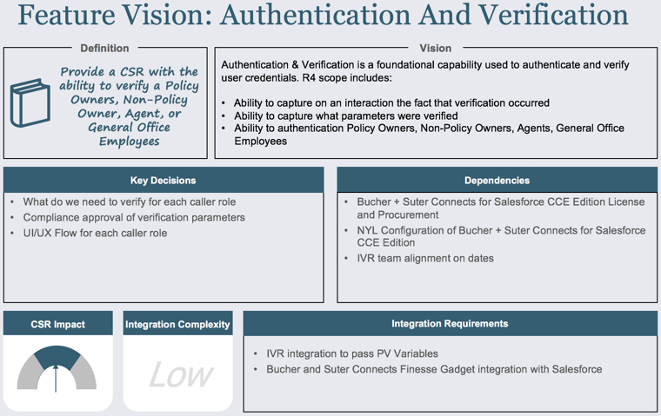

Authentication & Verification Example
Feature
Vision Discussions
Design
Discussions
User Story
Breakdown
User Story/
Solution Sign Off
Vision Slide: Define the vision for a Feature to level set across multiple stakeholders
Key Takeaways:
Provide a CSR with the ability to verify a Policy Owner, Non-Policy Owner, Agent, or General Office Employee
Ensure the Product Owner agrees to the Scope of the feature
Ensure all dependencies and integration requirements are thought of and called out
Ensure all teams needed to complete the feature are in agreement on the scope

Slide 12
Authentication & Verification Example
Feature
Vision Discussions
Design
Discussions
User Story
Breakdown
User Story/
Solution Sign Off
Detailed Process Flow: Define the vision for the Feature with a detailed process flow
Eg. CSR is verifying an Agent who is calling in
H
Authentication & Verification Detailed Process Flow PPT

Slide 13

Authentication & Verification Example
Feature
Vision Discussions
Design
Discussions
User Story
Breakdown
User Story/
Solution Sign Off
Persona Slide: Define what you need to understand about your user, in relation to your objectives
Customer Service Rep (“CSR”)
45
Main Goal:
Ability to verify a Policy Owners, Non-Policy Owner, Agent, or General Office Employees
Key Takeaways:
Current Pain Points/Issues:
• Not able to manually authenticate Policy Owners, Non-Policy Owners, Agents, General Office Employees in Salesforce Service Central
Not able to capture what parameters were verified in Salesforce
Ensure the Product Owner agrees to the end user group
Ensure the main requirements of the end users are captured, as well as, current pain points and issues
Main Requirements:
• Ability to capture on an interaction the fact that verification occurred
Ability to capture what parameters were verified
Ability to authenticate Policy Owners, Non-Policy Owners, Agents, General Office Employees

Slide 14
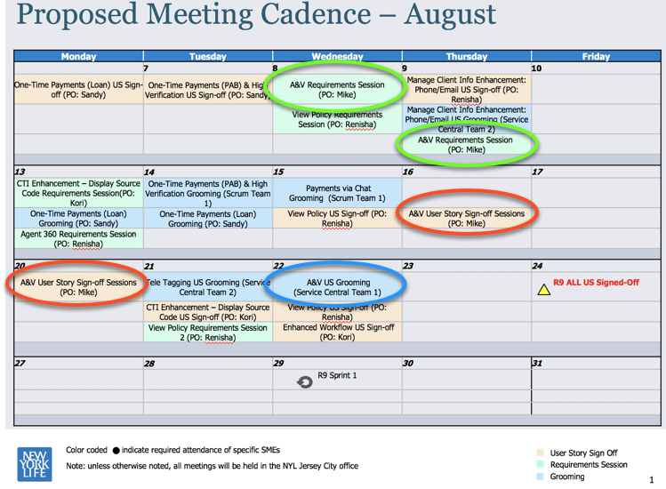
Authentication & Verification Example
Feature
Vision Discussions
Design
Discussions
User Story
Breakdown
User Story/
Solution Sign Off
Meeting Cadence: Set expectations with the Product Owner and team on when key meetings will be held and when attendance is needed
Key Takeaways:
Ensure the Product Owner agrees to the meeting cadence and the level of involvement needed
Ensure business SMEs and dependent teams also agree to level of involvement needed
Notes:
Key Meetings to Schedule:
Requirement Sessions: Schedule as many as needed and ensure the PO agrees to the proposed meeting cadence
User Story Sign off Sessions: Schedule first review session at least 2 days after the first draft of user stories have been sent to the PO for review
Grooming Sessions: Schedule grooming session with the dev team once user stories have been signed off

Slide 15
Authentication & Verification Example
Feature
Vision Discussions
Design
Discussions
User Story
Breakdown
User Story/
Solution Sign Off
After Vision discussion, Technical Solution lead drives discussions to create a solution design covering:
Salesforce Data Model
Technical Design details
Integration details
Data Migration
Technical Design details
3 Lightning Components
Search Screen (with tabs). Fetch all configuration information and keep handy with keys; show as per the tab selected
Search Results Screen (If additional fields added in future, it will flow inline) – show all SELECT Field values from the configuration Verification Screen
Build Dynamic Query based on the configuration
WHERE Clause by AND default (only for NOT NULL search fields), IF Search Results = 0 → WHERE Clause by OR
For Owner tab, branching logic to be written to handle different queries on Account/Asset/PartyRel depending on Policy Number is entered or not
Create Interaction Record and Verification Records based on Verify/Fail. Key-Value Pairs to be populated as per the ‘Verification’ type of records on Child Metadata Type
On Verification screen, auto-populate the attribute values on screen if it exists in Salesforce or just provide free-form text fields
Salesforce Data Model

Slide 16
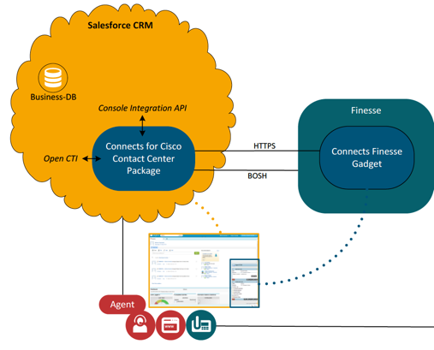
Authentication & Verification Example
Feature
Vision Discussions
Design
Discussions
User Story
Breakdown
User Story/
Solution Sign Off
After Vision discussion, Technical Solution lead drives discussions to create a solution design:
Integration Details
Key Takeaway:
Ensure the solution design is as detailed as possible and covers:
Salesforce Data Model
Technical Design details
Integration details
Data migration

Slide 17
Authentication & Verification Example
Feature
Vision Discussions
Design
Discussions
User Story
Breakdown
User Story/
Solution Sign Off
User Story breakdown:
Leverage the Vision slide, detailed process flow, persona slide, and technical solution details to breakdown and write the user stories for the feature.
Artifact
Vision Slide
Key Takeaways:
Use the Vision slide, Detailed Process Flow, Persona slide, and Technical solution details to breakdown user stories
Detailed Process Flow
1st Draft of User Stories
User Stories
Persona Slide
Review the structure of how you plan to breakdown the user stories with the technical solution lead
Technical Solution Details
Notes:
Persona: CSR
Workflow/Process Steps: Verification screens that a CSR will see for verifying an Agent that calls into Service Central
User Interface/Design: How will the verification screens look to the CSR
Business Rules: What parameters need to be verified and screen logic

Slide 18
Authentication & Verification Example
Feature
Vision Discussions
Design
Discussions
User Story
Breakdown
User Story/
Solution Sign Off
Example of user stories for Agent Verification broken out by UI and Logic/Rules:
Name: Interaction Screen AG.1 (UI)
Description:
As a CSR, when opening the interaction launcher,
I want to see a screen as depicted by Figure AG.1 in
the attached PowerPoint file,
So that I may see verify Agent information.
Acceptance Criteria:
GIVEN an Agent is being verified
WHEN the CSR opens the interaction launcher and selects the Agent tab
THEN a screen as depicted in AG.1 of the attached PowerPoint file will be displayed. When the CSR clicks on the Agent tab, the "Agent Code" field should be displayed.
Also, a "Cancel" and "Next" button will be on the bottom of the screen.
Name: Interaction Screen AG.1 (Rules/Logic)
Description:
As a CSR, when opening the interaction launcher,
I want to see a screen as depicted by Figure AG.1 in the attached PowerPoint file
with Agent Code required,
So that I may verify Agent information.
Acceptance Criteria:
GIVEN an Agent is being verified
WHEN the CSR opens the interaction launcher and selects the Agent tab
THEN a screen as depicted in AG.1 of the attached PowerPoint file will be displayed with the following rules/logic:
The "Agent Code" field should be required in order to click the "Next" button.
If no code is entered, and the CSR clicks Next, then an error message will be displayed at the top in red "Please enter an Agent Code".
If the Agent Code entered matches an Agent record in Salesforce then the CSR will be navigated to AG.2
If the Agent Code entered does not match an Agent record in Salesforce, then an error message will be displayed at the top in red “Agent Code does not exist”
When clicking "Cancel" the Agent Code field will be cleared.
Notes:
Persona: CSR
Workflow/Process Steps: Verification screens that a CSR will see for verifying an Agent that calls into Service Central
User Interface/Design: How will the verification screens look to the CSR
Business Rules: What parameters need to be verified and screen logic

Slide 19
Authentication & Verification Example
Feature
Vision Discussions
Design
Discussions
User Story
Breakdown
User Story/
Solution Sign Off
For user stories that require more technical details, work with technical team to ensure that the acceptance criteria contains all of the needed technical details to address the functional requirements.
Name: CTI A&V - Change to 3rd Screens - Display if a Password Exists
Description:
As a CSR,
I want to see a message on PO.3 if a password exists on a policy,
So that I can check on the policy and ask the caller for their password.
Acceptance Criteria:
Given a Password exists on a policy for a client,
When the CSR views PO.3,
Then the password should be displayed on PO.3. (Location: above verification fields)
(ViewPolicyContractAPI - FinancialContract.ContractOverview.PassKey)
If the API fails: “Password data is not currently available. Please refer to the legacy system.”
Name: Technical Story - Field Creation and Updates for Customer Interaction and Case
Description:
As the system,
I want to have additional fields created,
So that I can track and display customer interaction information correctly.
Acceptance Criteria:
Given a CSR has verified a caller,
When the customer interaction record is created,
Then the system should capture the following:
Field For Name of the Interaction – Non Hyperlink: vlocity_ins__CustomerInteraction__c.SRVC_Customer_Interaction_Name__c
Field For Hyperlink Auto Number: vlocity_ins__CustomerInteraction__c.SRVC_Customer_Interaction_Number__c

Slide 20
Authentication & Verification Example
Feature
Vision Discussions
Design
Discussions
User Story
Breakdown
User Story/
Solution Sign Off
Then user stories are reviewed with PO multiple times:
Small updates are made to user stories in sign off sessions
Once User Stories are approved, then Grooming with the Development team is scheduled
Final Technical Design/Solution Design is Signed off on after the user stories have been approved
Key Takeaways:
Communicate with technical solution lead if requirements change while reviewing and getting user stories signed off.
Even though changes in requirements might appear to be small, they could have larger impacts on the design.
Ensure the PO reviews all acceptance criteria and understands that the scope of work is limited to the Acceptance Criteria.

Slide 21
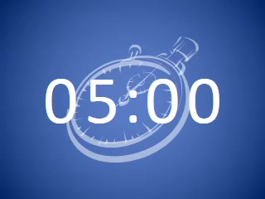
NY Life: Hands-On Exercise
Name: Interaction Screen AG.3 (Business Rules/Logic)
Description:
As a CSR, when manually verifying an Agent,
I want to see a screen as depicted by Figure AG.3 in the attached PowerPoint file with certain required fields and business logic,
so that I may verify the Agent according to Compliance requirements.
Acceptance Criteria:
Figure AG.3
AGENT
Agent Name
Auto-populated
X
P
GIVEN a CSR (Customer Service Profile or Customer Service Leadership Profile) has entered an "Agent Code" in AG.1 and clicked “Next”, and an agent record exists in Salesforce,
WHEN the CSR is navigated to AG.3 and proceeds to verify the Agent,
THEN the CSR should see a screen as depicted by Figure AG.3 in the attached PowerPoint file with the following rules/logic:
The Agent Name and Agent Code will be auto-populated based on the Agent record in Salesforce.
The CSR should be able to manually select either the green check or red x next to the Agent Name and Agent Code field.
The CSR must select the “Agent” or “Assistant” checkbox, if the CSR selects Assistant, then the CSR can optionally enter in the caller name (Caller Name field will be editable only if “Assistant’ is checked).
The CSR should be able to manually populate the Policy Number field and SSN field
The CSR will be able to successfully Verify the Agent if all of the following are true:
(1 and 2 and 3):
Agent Name and Agent Code are checked as Verified
Agent or Assistant is checked
Policy Number and/or SSN is populated
Clicking Verify (successful verification) will close the interaction screen and the Agent record will open in a new tab and the Type field on the Customer Interaction record associated to the Agent will be updated with “Pass”.
Clicking Verify (unsuccessful/required fields not populated) error messages covered under USXXXXXX.
Clicking Fail will close the interaction screen, and the Type field on the Customer Interaction record associated to the agent will be updated with “Fail”.
Clicking Back will return the CSR to AG.1.
Agent Code
Auto-populated
X
P
Agent
Assistant
Caller Name
Optional
Policy Number
Must enter one:
SSN
Back
Fail
Verify

Slide 22
Key takeaways
Ensure the Product Owner agrees to the Scope of the feature
Ensure all dependencies and integration requirements are thought of and called out
Ensure all teams needed to complete the feature are in agreement on the scope
Ensure the Product Owner agrees to the end user group
Ensure the main requirements of the end users are captured, as well as, current pain points and issues
Ensure the Product Owner agrees to the meeting cadence and the level of involvement needed
Ensure business SMEs and dependent teams also agree to level of involvement needed
Ensure the solution design is as detailed as possible
Use the Vision slide, Detailed Process Flow, Persona slide, and Technical solution details to breakdown user stories
Review the structure of how you plan to breakdown the user stories with the technical solution lead
Communicate with technical solution lead if requirements change while reviewing and getting user stories signed off.
Ensure the PO reviews all acceptance criteria and understands that the scope of work is limited to the Acceptance criteria.

Slide 23
What’s Next
We will continue our journey of writing better user stories together
User Story Desk : On demand trainings for project
Publish best in class examples
Studio, Delivery Center and USI follow up sessions
AM&C and CCG Follow up sessions
CE&E US User Story Training re-run

Slide 24
Our Ask
Improve quality of user stories on your project
LEARN
REVIEW
GET LEADERSHIP ATTENTION EARLY
CALL FOR HELP
Use Agile learning resources and best in class samples to get smart on writing user stories
Individual and team review of the processes and structures for writing user stories to identify cause and potential resolution
Get leadership’s attention to poor user stories as early as possible
Engage a Deloitte coach
Reach out to agile experts within C&M to get stories reviewed

Slide 25
Q & A

Slide 26

Our team
Doug Hoover
Ankur Gautam
Pooja Shah
Kara Donato
Brooks Toth
Specialist Leader
Senior Manager
Senior Manager
Senior Consultant
Senior Consultant

